Slide 1

RUNGTA COLLEGE OF DENTAL SCIENCES & RESEARCH
TITLE OF THE TOPIC: COMPLEXAMALGAM RESTORATION
DEPARTMENT OF CONSERVATIVE DENTISTRY AND ENDODONTICS

Slide 2
Specific learning Objectives
At the end of this presentation the learner is expected to know ;
Core areas* | Domain ** | Category #
PIN INSERTION | COGNITIVE | MUST NOW
MICROCRACKING AND CRAZING | PSYCHOMOTOR | NICE TO KNOW
FACTORS AFFECTING MICROCRACKING | AFFECTIVE | DESIRE TO KNOW

Slide 3
CONTENTS
Mechano anatomical principles for pin placement
Principles for pin placement.
Complication during pin placement
Failure of pin retained restorations
Slot retained amalgam restorations
Amalgam foundations
Chamber retention
Restorative technique
Bonded amalgam
Conclusion
References

Slide 4
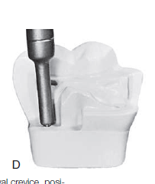
The drill is then viewed from a 90-degree angle to the previous viewing position to ascertain that the drill also is angled correctly in this plane
With the drill tip in its proper position and with the hand piece rotating at very low speed (300–500 rpm), pressure is applied to the drill until the depth-limiting portion of the drill is reached
the pinhole is prepared in one or two movements without allowing the drill to stop rotating.

Slide 5
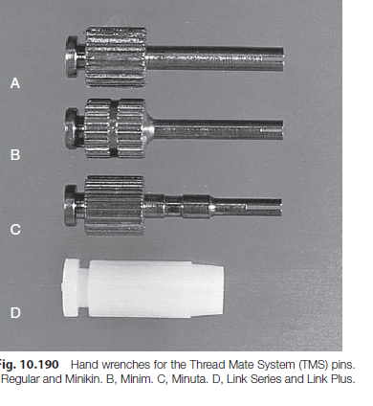
PIN IN﻿SERTION
the TMS utilizes hand wrenches to place the self-threading pins
Link Series and Link Plus pins are contained in color-coded plastic sleeves that fit a latch-type contra-angle handpiece or a specially designed plastic hand wrench
the latch-type handpiece is recommended for the insertion of the Link Series and the Link Plus pins.
the hand wrench is recommended for the insertion of standard pins.

Slide 6
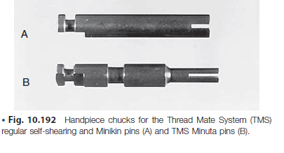
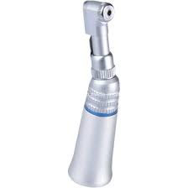
When using the latch-type handpiece, a Link Series or a Link Plus pin is inserted into the handpiece and positioned over the pinhole.
the handpiece is activated at low speed until the plastic sleeve shears from the pin.
the pin sleeve is then discarded.

Slide 7
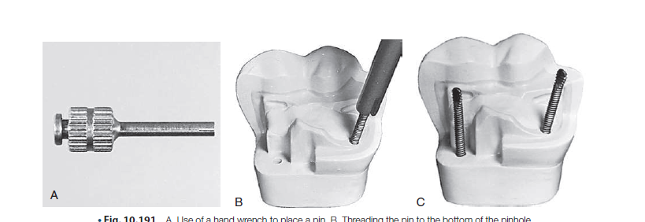
A standard pin is placed in the appropriate hand wrench and slowly threaded clockwise into the pinhole until a definite resistance (indicating the pin has reached the bottom of the pin hole) is felt
The pin should then be rotated one quarter to one half turn counter clockwise to reduce the dentinal stress created by the end of the pin that is pressing on dentin at the bottom of the pinhole.
The hand wrench should be removed from the pin carefully

Slide 8
Once the pins are placed, evaluate their length. 2 mm is optimal (into amalgam).
To remove excess length, use a sharp No ¼, ½ or 169 L bur at high speed and oriented perpendicular to the pin.
If oriented otherwise, the rotation of the bur may loosen the pin by rotating it counter clock wise.
After placement, the pin should be tight, immobile and not easily with drawn

Slide 9
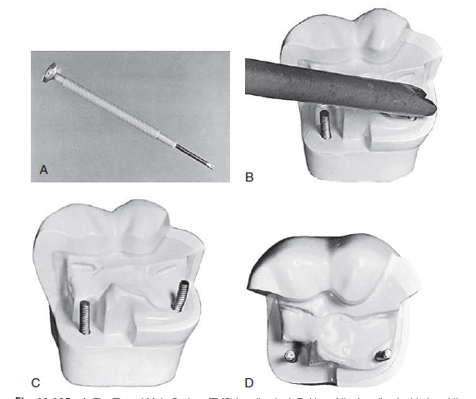
Pins can be bent to position them within the anticipated contour of the final restoration.
But they are not to be bend to make them parallel or increase their retentiveness.
Use the TMS bending tool.
The bending tool should be placed on the pin where it is to be bend and with firm controlled pressure, the bending tool should be rotated until the desired amount of bend is achieved.
A, The Thread Mate System (TMS) bending tool. B, Use of the bending tool to bend the pin.
C and D, The pin is bent to a position that provides adequate bulk of amalgam between the pin and
the external surface of the final restoration

Slide 10
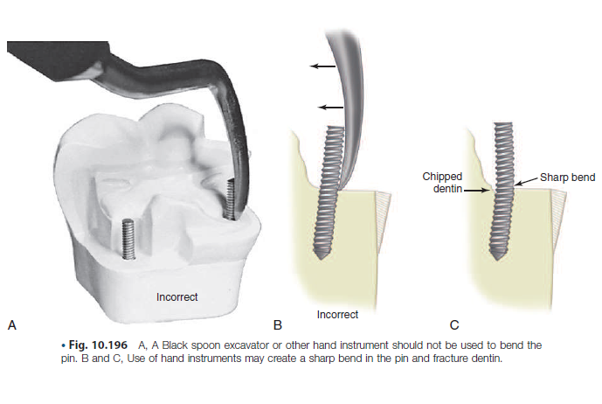

Slide 11
ANATOMICAL ASPECT
MECHANICAL ASPECTS
MECHANO – ANATOMICAL ASPECTS

Slide 12
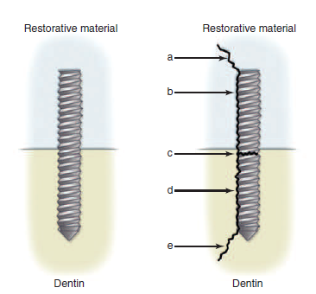
MECHANICAL ASPECT:
PIN AND TOOTH STRUCTURE
Stressing capabilities of pins
Retention of pins in dentin
Microcracking and crazing
PIN AND RESTORATIVE MATERIAL
Effect of pin on the strength of the amalgam
Retention of the pin to restorative material

Slide 13
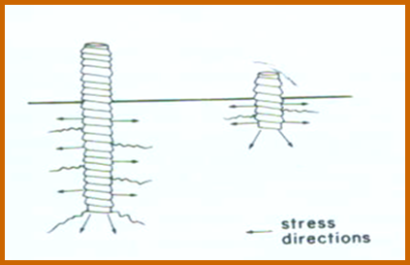
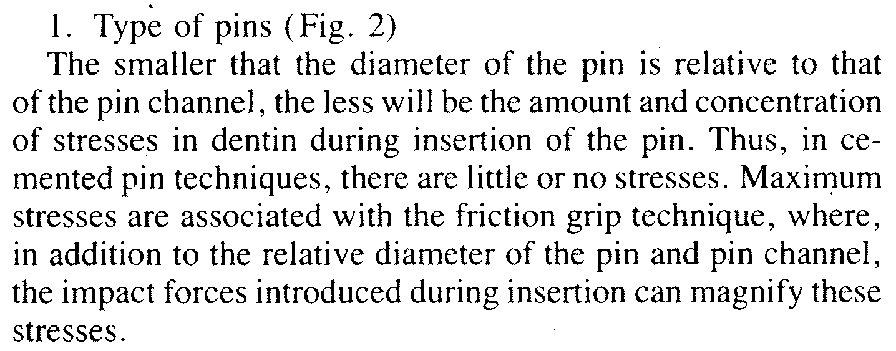
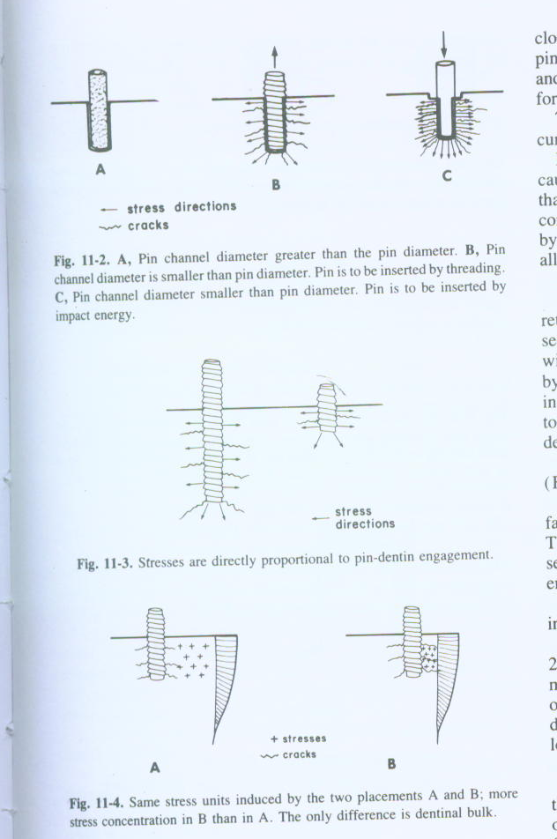
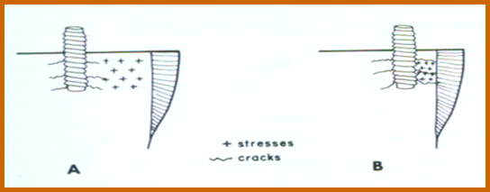
STRESSING CAPABILITIES OF PINS
PIN AND TOOTH STRUCTURE
Factors that will affect stresses are
Type of pins
Notes:
During pin placement stresses occur.when these stresses exceeds the elastic limit of dentin permnt deformatn occur

Slide 14
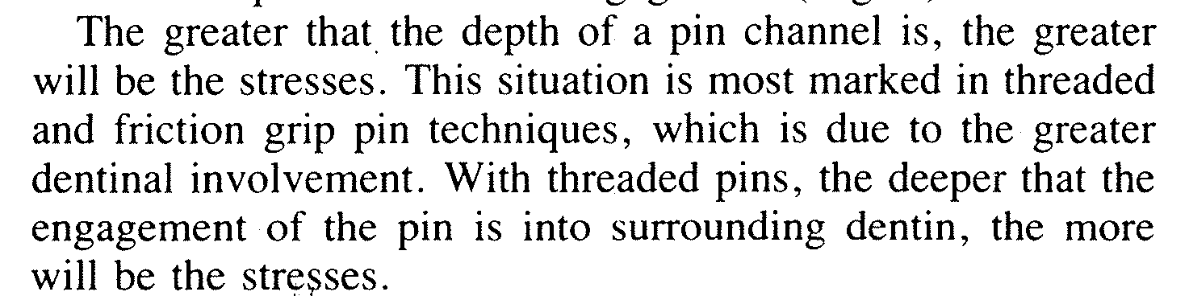
Diameter of pins
Pin depth and dentinal engagement
Bulk of dentin
Type of dentin
less stress for Regular primary dentin of young teeth because of its high elastic and plastic limit
Stress tolerance in decreasing order
secondary.>sclerosed >tertiary dentin>calcific barrier

Slide 15
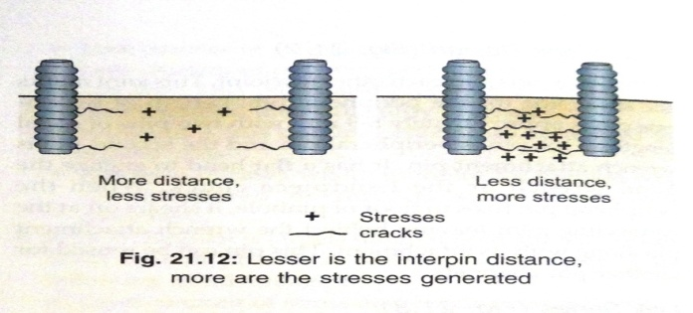
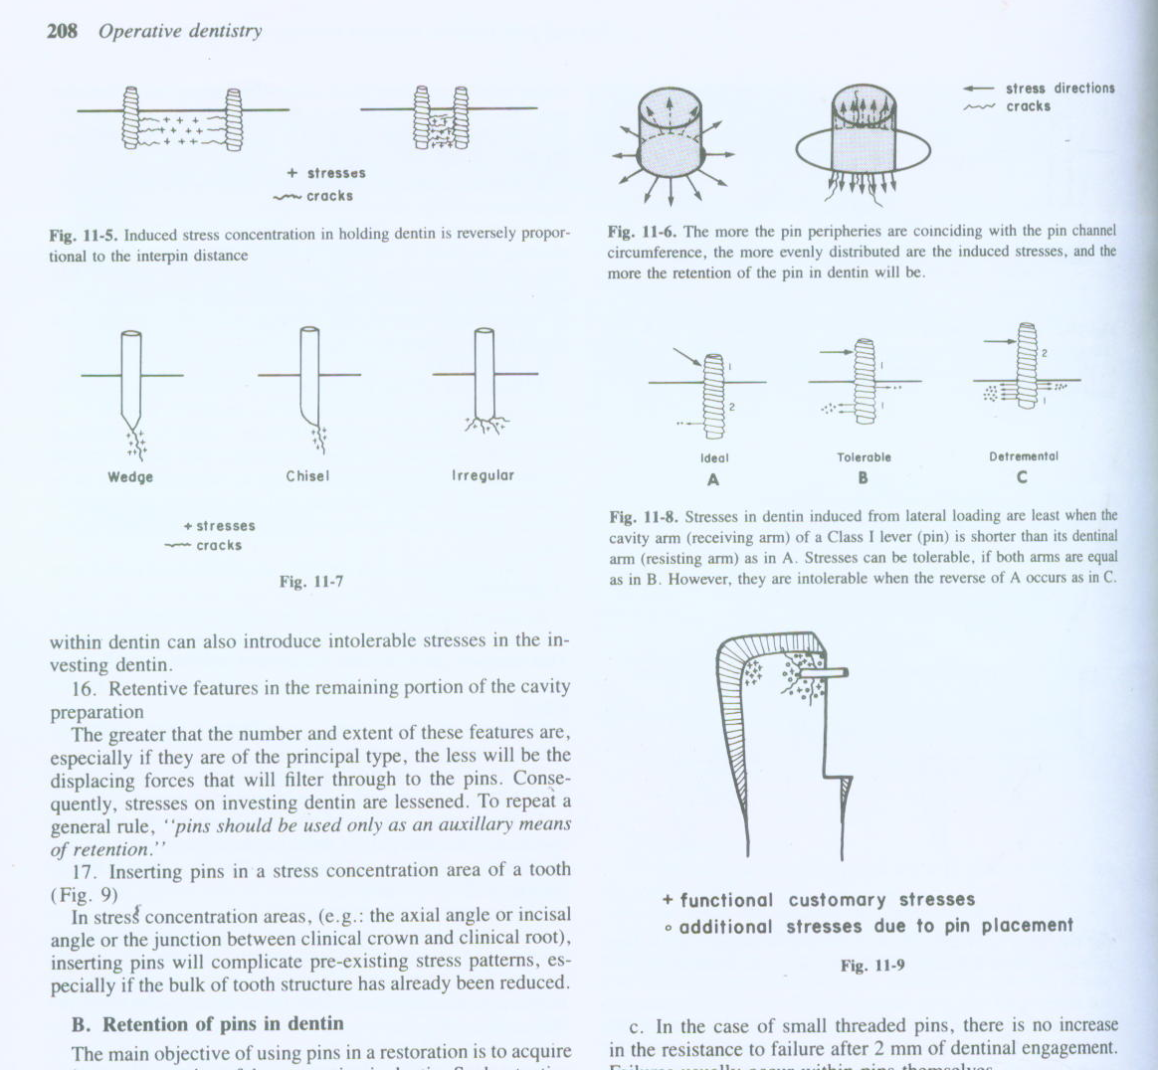
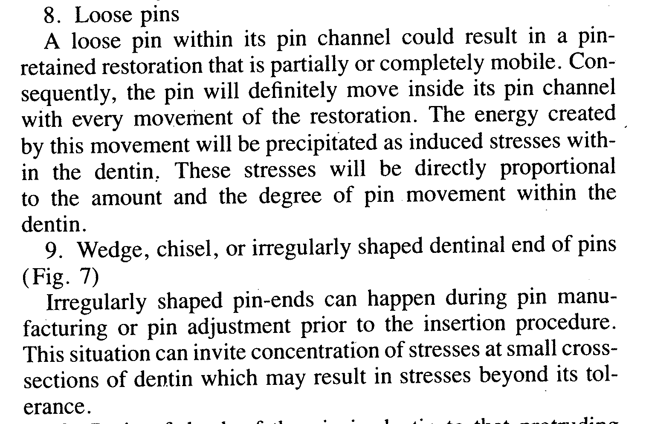
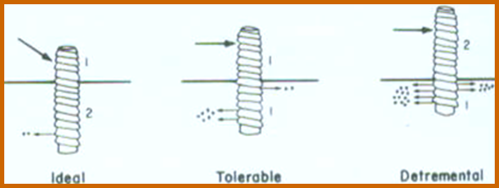
6. Interpin distance:
The closer the pins are inserted to each other the greater will be stress
7. Loose Pins:stresses will be directly proportional to the amount and the degree of pin-movement within the dentin.

Slide 16
9. Number of pins in one tooth:
Number of pins per unit volume decides the stress induced
10. Over threading or over driving of pins into the pin channel
11. Ratio of depth of the pin in dentin to that protruding into the cavity preparation:
The ideal ratio of dentinal engagement to pin protrusion is 2: 1
Ratio of embedded pin and exposed pin length if not 1: 1 induces harmful stresses.

Slide 17
Inserting pins on a stress concentrating area: (eg: the axial angle, incisal angle or the junction between clinical crown and clinical root)
Stresses induced during shortening pins inside the cavity preparation:
After dentinal engagement, any energy not consumed in cutting the pin can induce intolerable stresses in the involved dentin.
Bending or aligning pins after their dentinal engagement:

Slide 18
Retentive features in the remaining portion of the cavity preparation
Noncoinciding eccentricity in pins or pin channel circumference
Twist drill variability:
Blunt edged drills ,vibrating drills or a twist drill used with laterally applied forces can magnify the induced stresses in the dentin.

Slide 19
RETENTION OF PINS IN DENTIN
Factors affecting retention of pins in tooth structure:
a. Type of pins:
self threading pin >friction locked pin >the cemented pin
b. Depth of pin engagement in dentin:
Increasing the depth of the pin in dentin increases the retention values.
Moffa et al (1969) demonstrated that at depths greater than 2mm, attempts to remove a smaller self threading pin fractured the pin, where as a larger self threading pin fractured the dentin.

Slide 20
Pin diameter:
Within limits as the diameter of the pin increases the retention increases.
retention values almost double when the diameter of the pin increases from 0.0155" to 0.0230".
However the practical limitation of having appropriate amount of dentin around pin would warrant use of smaller diameter pins.

Slide 21
d. Number of pins:
number of pins increases → retention in dentin increases
At interpin distances of less than 2mm, there is interaction of stresses in dentin resulting in loss of retention. Due to microcracks occurring during placement of pins.
Cementing agents:
In case of cemented pins ➔ copper phosphate cement(used only in nonvital teeth).
Zinc phosphate >polycarboxylate>zinc oxide eugenol
Use of varnish with zinc phosphate decreases its retaining power by 40%

Slide 22
Type of involved dentin:
- Young, resilient, primary dentin is the most retaining type of dentin, followed by tubular secondary dentin.
Hyper mineralization (sclerosis and calcification) and dehydration (non vitality) of dentin ➔ decrease its pin-retaining power.
. Surface roughness of pins:
Pins with surface serration or threading ➔increased retention in dentin especially in case of cemented pin technique.

Slide 23
The ratio of dentinal engagement of the pins to their protruding lengths in cavity preparations.
ideal ratio for pin retention during function is 2: 1
higher ratio → increase the pin retention,
lower ratio → decrease the retention.
. Bulk of dentin around the pin:
The greater the cross section of dentin separating the pins from the pulp, tooth and root surface → the greater retention.
due to the lesser number of interconnecting cracks per unit volume of dentin.

Slide 24
Mode of shortening of the pin after insertion:
Use smallest carbide bur 1/4 round 0r 699 bur.
Apply pressure in clockwise direction in case of threaded pin
Hold the instrument with haemostat while applying lateral cutting pressure
Use light intermittant pressure at the highest speed

Slide 25
MICROCRACKING AND CRAZING
The most common crazing and least detrimental to the tooth is that originating at the surface.
Crazing starting from the DEJ and appearing on the surface must penetrate the gnarled enamel implying that it is driven by much stronger and more destructive forces.
most common during indiscriminate use of high speed rotary instrumentation, frequent use of pins and posts in restorative dentistry.
Crazing can predispose to ‘Cracked tooth syndrome’.

Slide 26
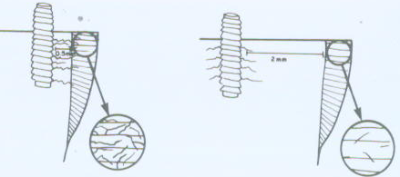
FACTORS INFLUENCING CRAZING
1. Types of pins
Cemented pins – least
Friction lock – maximum
Threaded pin - intermediate
2. Proximity of pins to DEJ
More crazing can be expected when a pin is inserted closer to DEJ.
Areas 0.5-1 mm from the DEJ are a safe location for cemented pins,
1.5-2 mm from DEJ is safe for threaded pins.

Slide 27
3.Any factor that will enhance stress induction in dentin can definitely increase the possibility of enamel crazing.
4. The thinner the adjacent enamel the greater will be the possibility of crazing within it.
5. Type of dentin between the pin and adjacent enamel.
The greater the dehydration or mineralisation, the faster a crack will travel from the pin site to the enamel, the greater will be the possibility of crazing.

Slide 28
PINS AND RESTORATIVE MATERIAL:
Pins ➔ reduce the strength of restorations because of the absence of any chemical union between the pin and restorative material at the interface.
Voids and irregularities are present at the interface or the pin is → serve as a void in restorative material and hence acts as a stress initiator.
Fractures in the pin amalgam restorations are commonly seen on planes involving pins.

Slide 29
Factors affecting retention of pins in restorative materials:
1. Type of pins:
Friction grip pins → least retentive for amalgam and composite resins due to their smooth surfaces.
Cemented pins and threaded pins ➔ four times more retentive than the friction grip (gnarled and threaded roughness of their surfaces).

Slide 30
2. Pin length in restorative material:
Within limits, increasing the length of the pin in restorative material increases retention.
For cemented pin of sizes 0.018” and 0.023” and the smaller threaded pins of size 0.02311 depth of greater than 2mm increases the chances of restoration failure.
- Hence the optimal length of these pins in the restorative material is considered to be 2mm.

Slide 31
3. Pin Diameter:
There is a gradual increase in pin retention to restorative material with increasing pin diameter up to 0.035”.
Any diameter larger than this will have no significant increased in retention.
4. Interpin Distance:
Bringing pins close to each other will increased retention up to a distance of 2mm.
Interpin distance closer than this will cause a definite reduction in the pin retention with in restorative material

Slide 32
5.Pin Shape:
Retentive cleats and square or pear shaped heads on the pins improve retention to restorative material.
6. Surface material of the Pins:
- If the surface layer of the pin can chemically combine with the restorative materials or one of its phases ,a continuous interphase can be achieved. Unfortunately this has not been possible as yet.
Gold plated or silver plated stainless steel pins have been tried with the aim of reacting with silver amalgam but are not very effective.

Slide 33
8. Bulk of material surrounding the pin:
Pin retention decreases with the decrease in bulk of material surrounding the pin.

Slide 34
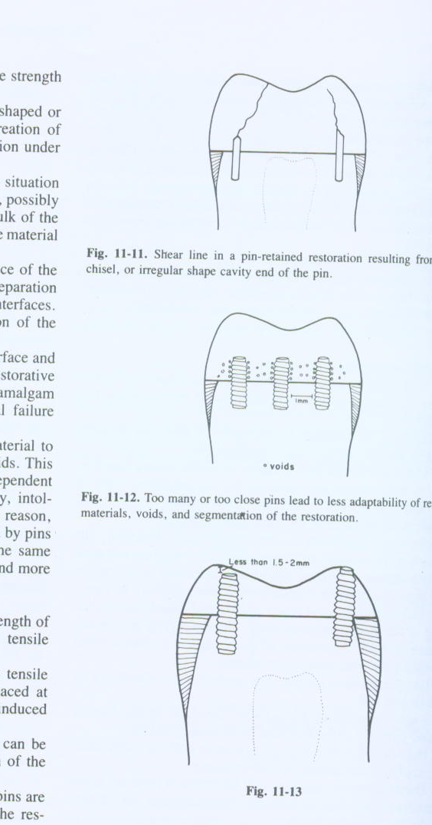
EFFECT OF PIN ON THE STRENGTH OF RESTORATION
Compressive strength :
A.Pins will not increase the compressive strength of the restorative material
B. If pins are closer than 2 mm to each other, strength of the restorative material is reduced due to incidence of voids and decreased bulk of the material.
C. If less than 1.5-2 mm exists between the pin surface and the restoration surface, the bulk of the restoration will be less ➔ reduced strength.

Slide 35
TAKE HOME MESSAGE
Because of its history, the complex amalgam restorations may be the most frequently placed complex restoration.
However due to the increasing benefits of composites, the many types of auxiliary retention forms available, and the variations of tooth preparations required for complex restorations, the operator should be familiar with all of these techniques, if he or she is to use these restorations on a regular basis.

Slide 36
QUESTIONS
WHAT IS MICROCRACKING
WHAT IS CRAZING
FACTORS AFFECTING MICROCRACKING
FACTORS AFFECTING CRAZING

Slide 37
REFERENCES:
1. Sturdevant's Art and Science of Operative Dentistry - fourth Edition
2. Operative Dentistry - Modern theory and practice - First Edition- M.A. Marzouk
3. Text book of operative dentistry - Vimal K. Sikri
4.Fundamentals of Operative Dentistry- Summit JB- 2nd edition
5.Text book of operative dentistry → nisha carg,amit carg
6.Principles and Practice of Operative Dentistry-Gerald T. Charbeneau-Third edition.
7.Clinical operative dentistry-principles and practice→ramya Raghu,Raghu sreenivasan

Slide 38
THANK YOU

